Slide 1
ACPPLD National Committee 2023

Slide 2
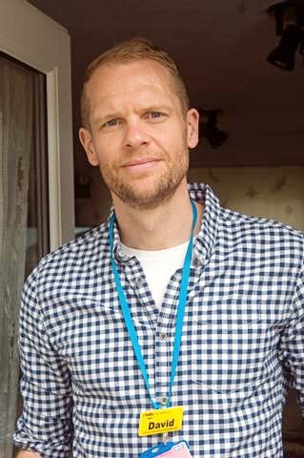
Chair
David Standley
I am very proud to take over from Jenny Tinkler as the Chair of the ACPPLD. They are very big shoes to fill! I am committed to working with the NEC to improve physiotherapy for people with a learning disability and represent learning disability physiotherapists from across the UK. We have some really exciting projects planned for 2023 so watch this space!! Before taking on the role of chair I was research and education officer which I enjoyed very much, and represented the ACPPLD on a number of national groups.
I co-authored the Standards of Practice for Physiotherapist working with Adults with a Learning Disability with Sarah Bruce. These were published in December 2019 and are currently under review which we plan to launch later in 2023.
I am a clinical specialist physiotherapist working for an adult community leaning disability team in South East London. Clinically, I have a special interest in the postural and respiratory management of people with complex physical and learning disabilities. But I am also interested in supervision, management and leadership especially using data analysis to understand and support the day to day management of the team and service.

Slide 3
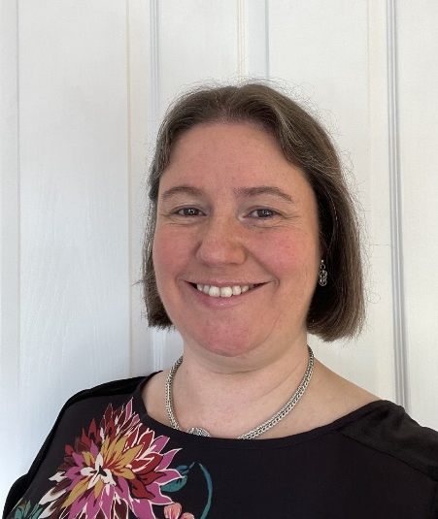
Membership Officer
Amanda Leech
I am Amanda Leech and I am your membership officer. I have been a member of the ACPPLD for 23 years. I was a member of the Scottish region Committee for over 10 years mainly carrying out the role of study day organiser and whilst still on the Scottish Committee I was also elected onto the national executive committee in 2007. For most of my time on the national committee I have been your website and social media officer, but last year I passed on that mantle and took up the role as membership officer when Liz Griffen stepped down.
In my day job I work up in NHS Fife in Scotland where I am the Head of Profession for Physiotherapy. Prior to having my current job I was a Learning Disabilities Physiotherapist for 21 years and although this clinical work is no longer part of my daily role, it remains my passion and I keep strong links with our LD Physio team as well as being the strategic lead for Postural care across our organisation.
I love being part of the ACPPLD network and the opportunities we get to promote the role of Learning Disability Physiotherapy and support each other as peers, are great. If anyone needs to contact me about membership enquiries you can use the ‘contact us’ section of the website or you can email me directly on acppld1@gmail.com

Slide 4
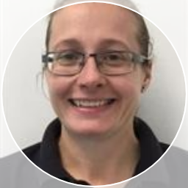
Treasurer
Jacqui Etherington
I am Jacqui and I am your Treasurer. I have been a member of the ACPPLD for 19 years. For most of my time on the national committee I have been your treasurer following a brief stint as the Diversity officer (when there was such a role).
In my day job I work in Gateshead, Northumberland and North Tyneside Community Learning Disabilities Teams as an Extended Scope Practitioner and Clinical Lead Physiotherapist. I am very passionate about promoting the rights of our client group to access all aspects of healthcare, where reasonably possible, and being part of the ACPPLD Network gives me the knowledge and skills framework to advocate this.
I love the opportunities I get to promote the role of Learning Disability Physiotherapy, building nationwide links and seeking various expertise to promote positive effect and information sharing. If anyone needs to contact me about Treasurer enquiries, you can use the ‘contact us’ section of the website or email me directly on acppld1@gmail.com

Slide 5
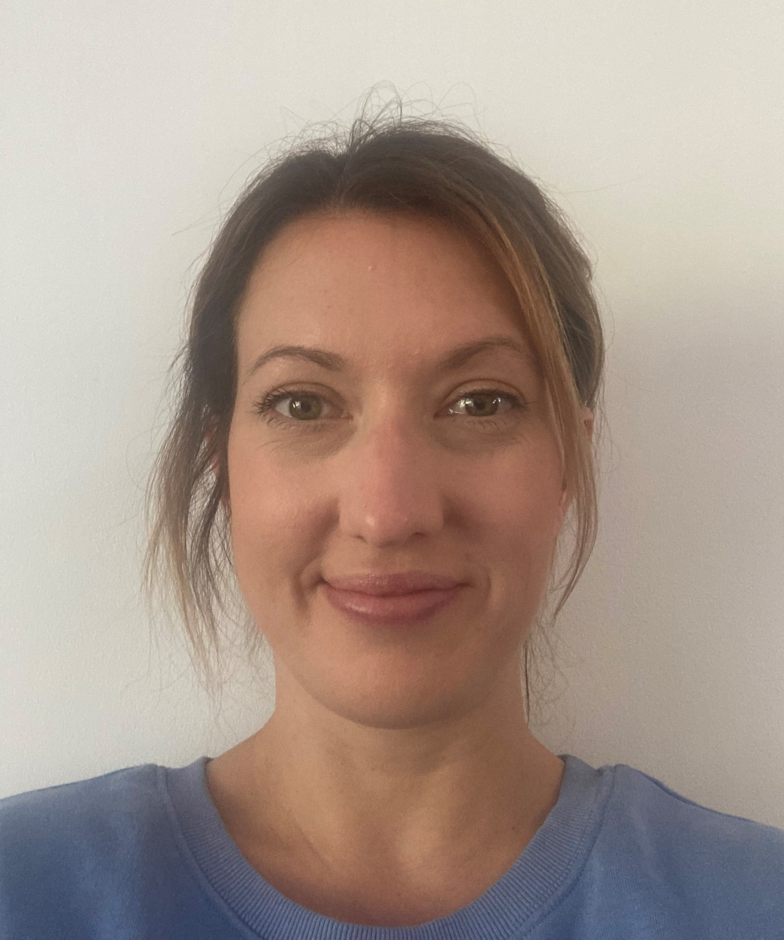
Regions Officer
Laura Sharp
Hi, I’m Laura and I am your regions officer. I qualified as a physiotherapist in 2007 and have been working in learning disabilities since 2009. I currently work in the LD team in County Durham. My area of clinical interest is in 24 hour posture management and I am currently completing the Post Graduate Certificate in Posture Management.
I joined the ACPPLD Northern Region committee many years ago, and am currently the area rep and treasurer for the region. Last year, I was lucky enough to be nominated onto the National Committee, and have taken on the role of regions officer. I love meeting other people who work in this area and have always loved attending the regional reps days, so this felt like the natural next step.
Working on both the regional and national committee’s is a fantastic opportunity, and I’m looking forward to the learning and development opportunities and meeting more members!

Slide 6
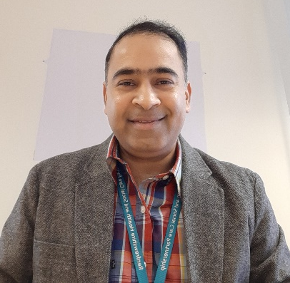
Website Officer
Sudhakar Sharma
I joined ACPPLD Scottish region team in 2006 and have benefitted immensely from being a member. From the inception ACPPLD guidance and networking has made me a better professional. As the years flew past I felt it was my time to ‘pay back’, hence I joined the Scottish Region as Secretary in 2020-21 and last year had the privilege join the NEC as Website Officer. These roles give me the opportunity to work (virtually) and learn from my colleagues across the whole UK.
I did my Bachelor's in Physiotherapy from India in 1999 and completed my Master's degree from Queen Margaret University Edinburgh in 2005. Following which I joined the 'lovely' Renfrewshire Community LD Team in 2006 – my extended family! We are one of the very successful integrated team from Scotland.
I love the LD client group I work with and the challenges that come with my role. The most exciting part is that being a MDT member I'm never just a physiotherapist! I have to keep switching my hats to see things from a wider perspectives and to ensure that I keep my colleagues busy with 'cross referrals'.
Postural care and management have been my key focus over the years. I had the privilege to contribute to Scotland’s Postural Care Strategy – Your Posture Matters! I am currently working on a project with NHS Education for Scotland to create an online learning resource on Postural Care.
In the end would state that if your physiotherapy job profile is in learning disabilities then ACPPLD is the group to be in! Please join us in improving the care of LD clients. Thank you!

Slide 7
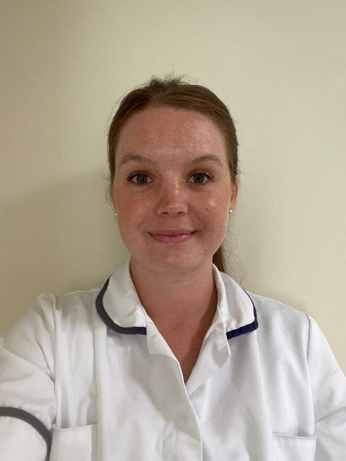
Secretary
Jestine Fennessy
Hello, my name is Jestine Fennessy and I am a Learning Disability Physiotherapist in County Durham. I joined the ACCPLD Northern region committee as a co-opted member over 10 years ago and developed into the role of secretary. I was recently elected to the national executive committee (NEC), having nominated myself after being part of the organising committee for the 2022 Annual Learning Event in York. I attended my first NEC meeting in January and have taken on the role of the NEC secretary.
I have a special interest in 24 Hour Postural Management, and I am currently completing a Post Graduate Certificate in Postural Management for People with Complex Disability in Oxford. I’m really looking forward to being part of the NEC alongside my role with the Northern region committee. It’s a fantastic opportunity for development and networking with the ACCPLD membership. I would encourage anyone thinking about joining their regional committee to do it! 😊

Slide 8
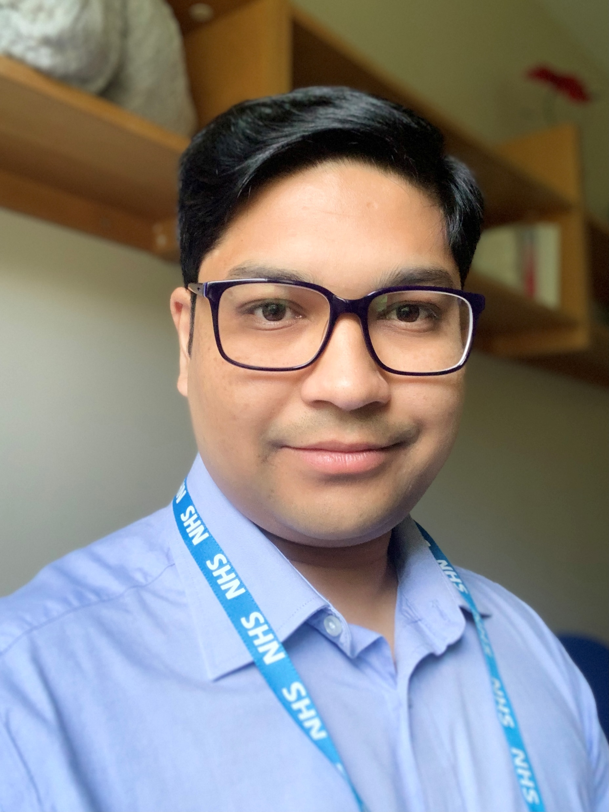
Social Media Officer
Deepak Agnihotri
I am the social media officer at the ACPPLD and would like to connect with all the members using social media platforms to raise the profile of LD physiotherapists. I am a Health and Care Professionals Council (HCPC) registered physiotherapist and Advanced Clinical Practitioner (ACP) with extensive experience of working in the learning disabilities service in the Northwest of England. I am passionate about quality improvement and clinical leadership provided by advanced clinical practitioners to provide innovative and person-centered care to people with learning disabilities and / or autism, meeting the needs of all our communities.
As a National Clinical advisor, I am leading the implementation of the national Advancing Practice in Learning disability and / or Autism network (APLDAN). As Training programme director for advancing practice, I am supporting trainee advanced practitioners, aspiring consultants and colleagues from diverse professional backgrounds, and ethnicities to become successful while working across 4 pillars – Clinical, Leadership, Education and Research. I work strategically at the local, regional, and national level in collaboration with other stakeholders and professional bodies to make a positive impact demonstrating the value of the role of advance practitioner and aspiring consultants in delivering person centred care for people with learning disabilities and / or autism.
I have worked as a member of Chief Allied Health Professions Officers BAME strategic advisory group at NHS England and Improvement. I was the chair of Diversity Alliance Network previously called Black Asian Minority Ethnic (BAME) + network at NHS trust in Northwest of England. I am honoured to have been awarded for outstanding contribution in October 2020 to the work of Equality, diversity, and inclusion from the Royal College of Nursing Northwest in celebration of Black History Month 2020. I utilise all this experience in continuing culture of openness and honesty to demonstrate that diverse leadership is critical to a thriving NHS.
I would like to encourage all the members of ACPPLD to come and join us on twitter @ACPPLD, use our social media platforms to raise the profile of our noble profession. It is our time to join the digital revolution to learn and share best practice to make a difference in the lives of people with learning disabilities and /or autism. If you have any ideas to improve our communication and reach to all our members and wider stakeholders then please directly message (DM) me @ACPPLD or @agnideepak.

Slide 9
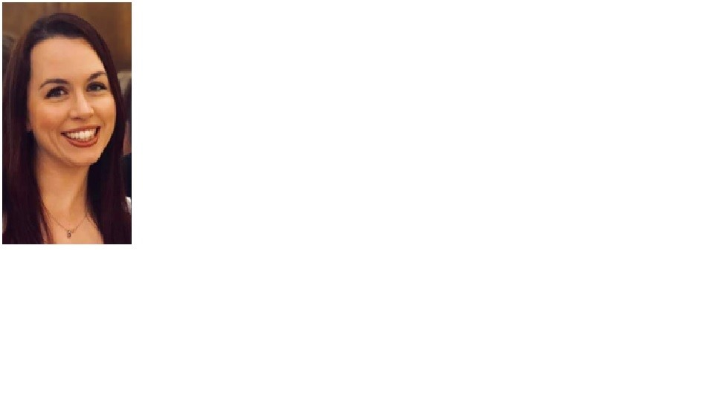
Research and Education Officer
Katrina McSorley
I have been a Physiotherapist since 2009, specialising in Learning Disabilities in 2012 working across Ayrshire and Arran taking up the role of Clinical Lead for East Ayrshire Learning Disability Physiotherapy team in 2021. During my time within my role, I have completed a M'Ed in Autism and utilised the knowledge and skills to assist in patient care and to support colleagues as required, taking a leading role in the development of Postural Care within the learning disability population.
I am currently the Scottish Area Rep for ACPPLD, I also have recently taken on the Research and Development role for the National Exec Committee. Additionally, I am a Specialist NHS advisor for Ayrshire Sportsability and hoping to assist with the engagement of adults with learning disabilities in sport within the local area. I am looking forward to continuing my roles with the ACPPLD, learning and supporting our members through the changing times we are working through.

Slide 10
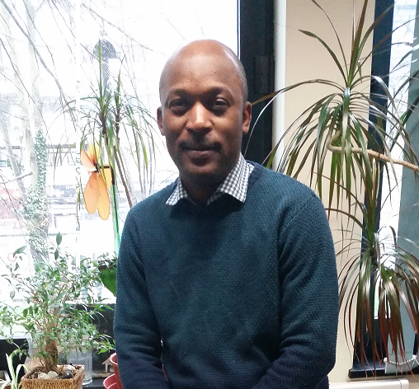
Supporting Newsletter Editor
Olu Sofuwa
My name is Olu and I have been a member of the ACPPLD since 2016. I have been the minutes secretary of the National Executive Committee (NEC) since 2017. With the growth of the NEC last year, I passed on the position and moved on to be supporting-editor of the Newsletter with Angie McMannus.
I work as Physiotherapy team Lead for the adult community LD service of Enfield for Barnet, Enfield and Haringey Mental Health Trust. Prior to this I worked in Neurorehab and later in LD in other Trust in Essex, Kent, Northamptonshire and Cambridgeshire.
I qualified as a Physiotherapist from the University of Lagos, Nigeria; and with post graduate qualification from K.U. Leuven, Belgium and University of Southampton.
Working in the field of Learning Disabilities has been a unique experience which gives me pleasure as it involves varied challenges, ‘thinking outside the box’ and wholistically of our client group. It is a honour to be part of the NEC to participate in influencing decisions and policies positively impacting and developing LD Physiotherapists and LD service.

Slide 11
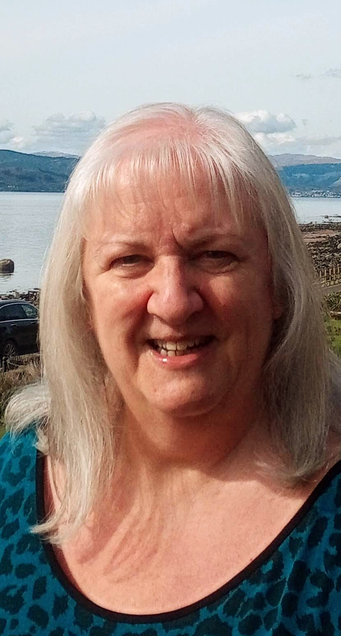
Newsletter Editor Angie McManus
I am Angie McManus and I’m your Newsletter Editor. I have been in this role on the National Executive Committee since September 2004 and I have been a member of the ACPPLD for more years than I’d like to consider! ☺ I joined the ACPPLD in 1988, serving on the Trent Regional Committee (when I worked in Yorkshire) and then serving on the Scottish Regional Committee, on which I still sit. I’ve worked in Learning Disabilities in various physiotherapy roles since 1988 progressing through a career which has taken me from clinical, to managerial, to Allied Health Professions Lead realms. I am no longer in the clinical field as a hands on practitioner, as I now work Strategically and Nationally. I’m delighted that I still hold portfolio for the Learning Disability Strategy within my Health and Social Care Partnership and I also hold a portfolio for our Postural Care Strategy across my organisation on behalf of AHPs in Tayside. Learning Disabilities is very much in my heart!
In my role as Newsletter Editor I am always delighted to hear from our membership with regards to any articles/or ideas they may wish to submit for inclusion in our ACPPLD Newsletter. I am always happy to help with any support needed around content, style and editing. Please do get in touch. It is such a great way to share and celebrate the great work which is done on a daily basis by everyone!
The ACPPLD has been a fantastic asset in my professional life, presenting me with so many great opportunities and positive connections which I can take into the various work environments I operate within. We have been able to influence and promote so many activities at so many levels. It’s a great Professional Network to be part of and to be proud of.

